Slide 1
Life Expectancy In African Countries:
A Panel Data Analysis
By Group 4:
Animesh Gupta 2019B3AA0588H
Chinmay Goyal 2019B3AA1290H
Harsh Vardhan Gupta 2019B3A70630H
Hitesh Garg 2019B3A70466H
Sujay Nigam 2019B3AA1267H
Aryan Kapadia 2019B3A70412H
Dhruv Gupta 2019B3A70487H
Anand 2019B3A70613H

Slide 2
Introduction
Research aims to determine the factors that influence life expectancy at birth for African countries
Multiple Linear Regression Fixed Effects Model
Panel data of 46 countries over a period of 17 years
Data has been sourced from the WHO database

Slide 3
Literature Review
Kabir (2008) : Determinants of Life Expectancy in Developing Countries
Hassan et al (2016): Social Environmental determinants of Life Expectancy in Developing Countries: A Panel Data Analysis
Anyanwu and Erihijakpor (2007): Health Expenditures and Health Outcomes In Africa
McCarthy (2000): Comparative Life Expectancy In Africa
Preston(1975, 2007) : The changing Relation between Mortality and Level of Economic Development
Hussain (2002): Life Expectancy in Developing Countries: A Cross-Sectional Analysis

Slide 4
Data and Methodology - Dataset
Country
Region
Year
Life_expect
Life_exp60
Adult_mortality
Infant_mort
age1-4mort
alcohol
BMI
age5-19thinnes
age5-19 obesity
hepatitis
measles
polio
diphtheria
basic_water
Doctors
GNI_capita
gghe-d
che_gdp
Une_pop
une_infant
une_life
une_hiv
une_gni
une_poverty
une_school
une_edu_spend
une_literacy

Slide 5
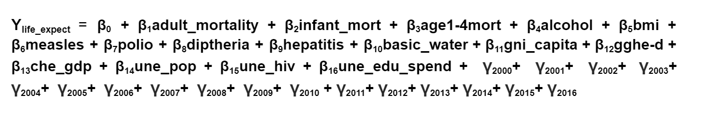
Data and Methodology - Econometric Model

Slide 6
Data and Methodology
Observations taken from random sample
Durbin–Wu–Hausman test suggests use of fixed effects model.
Modified Wald test to test for groupwise heteroskedasticity
Shapiro-Wilk test to test for normality of residuals
VIF test and pearson correlation matrix to check for multicollinearity

Slide 7
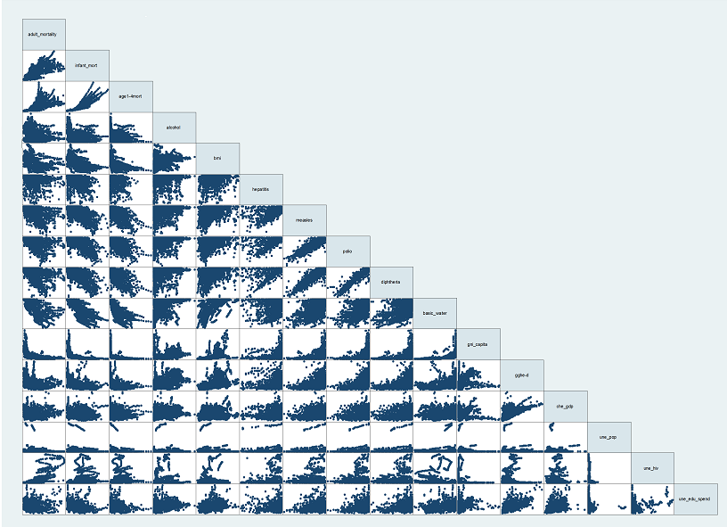
Data and Methodology - Graph matrix

Slide 8
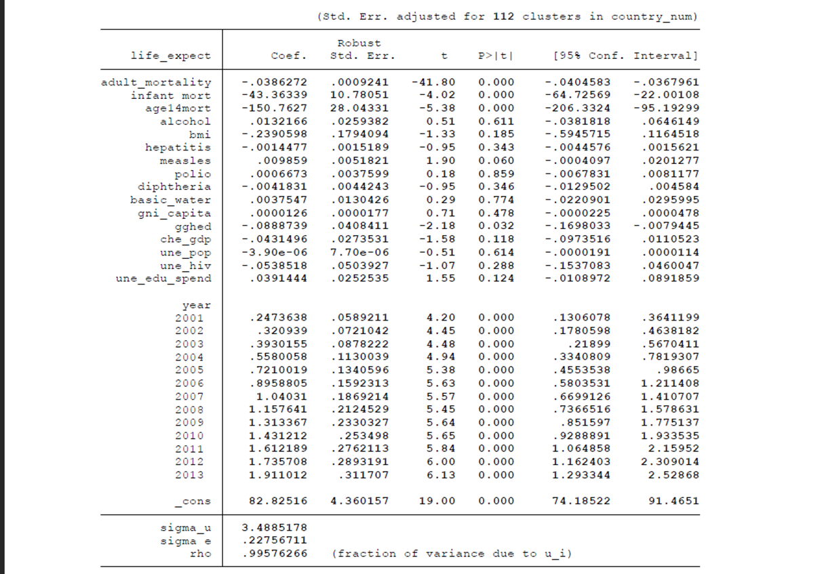
Results and Discussion: Summary statistics
Creating dummy variables for each year
Base Case
R² = 0.9792 (High correlation?)
F-value = 582.24
Significant & Insignificant variables
Interpretations
age14mort v/s other mortalities
Unexpected results
gghed’s sign
HIV’s insignificance

Slide 9
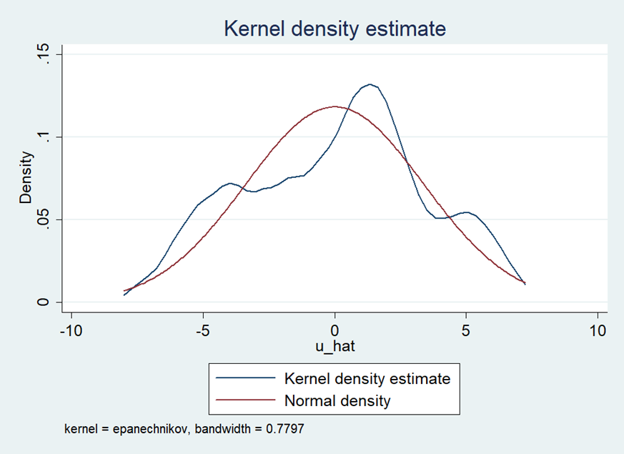
Checking for the assumption of OLS
Linear in Parameters
Random sampling of data
Zero conditional mean (E(ui|xi) = 0) : Approximately centered at zero mean
Notes:
In statistics, kernel density estimation (KDE) is a non-parametric way to estimate the probability density function of a random variable.

Slide 10
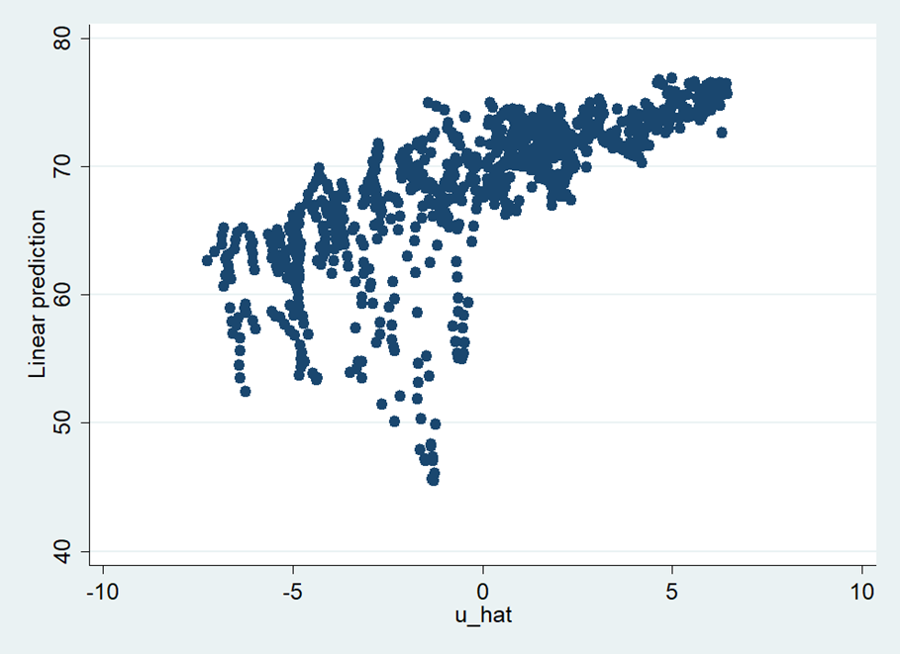
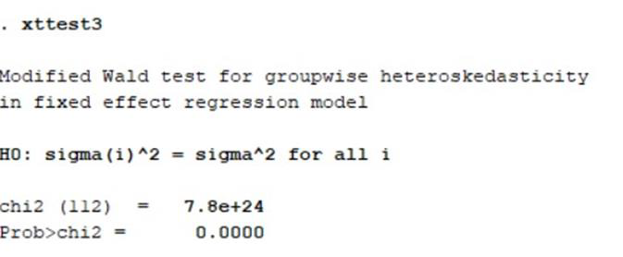
Checking for the assumptions of OLS
Homoscedasticity of error term: Funnel shape -> Heteroscedastic
Modified Wald Test for groupwise heteroskedasticity in fixed effect regression model
Notes:
Lower precision increases the likelihood that the coefficient estimates are further from the correct population value. Heteroscedasticity tends to produce p-values that are smaller than they should be.

Slide 11
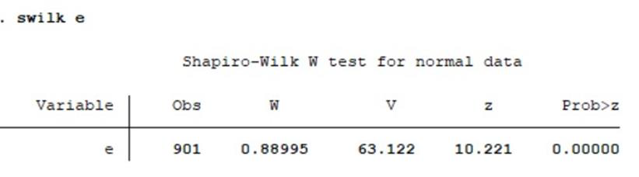
Checking for the assumptions of OLS
Normality of residuals : Shapiro-Wilk test

Slide 12
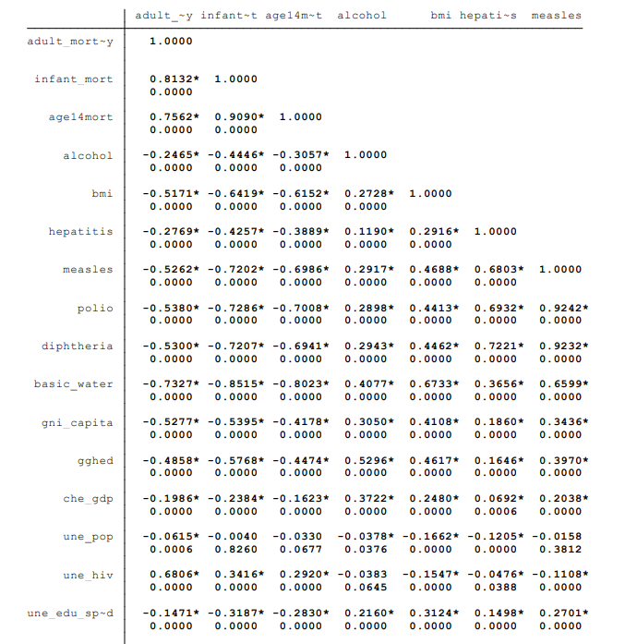
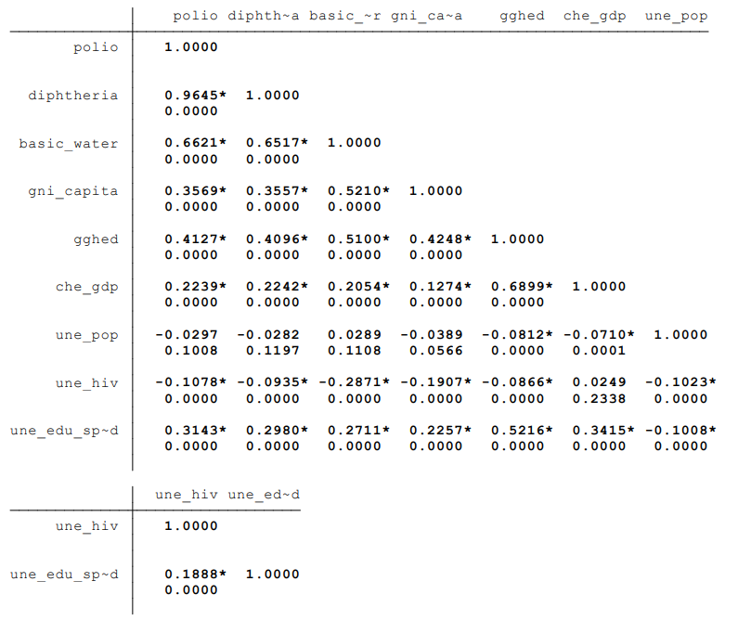
Checking for the assumptions of OLS
Multicollinearity - Pearson Correlation matrix

Slide 13
Model Diagnostics
Issues in the model:
Heteroskedasticity
Non-normality of residuals

Slide 14
Rectification of Heteroskedasticity
Attempted Transformation: log(life_expect)
Xttest3 still showed that heteroskedasticity exists in the model
Robust standard errors
White standard errors were used to combat the effects of heteroskedasticity by using the “robust parameter” of xtreg

Slide 15
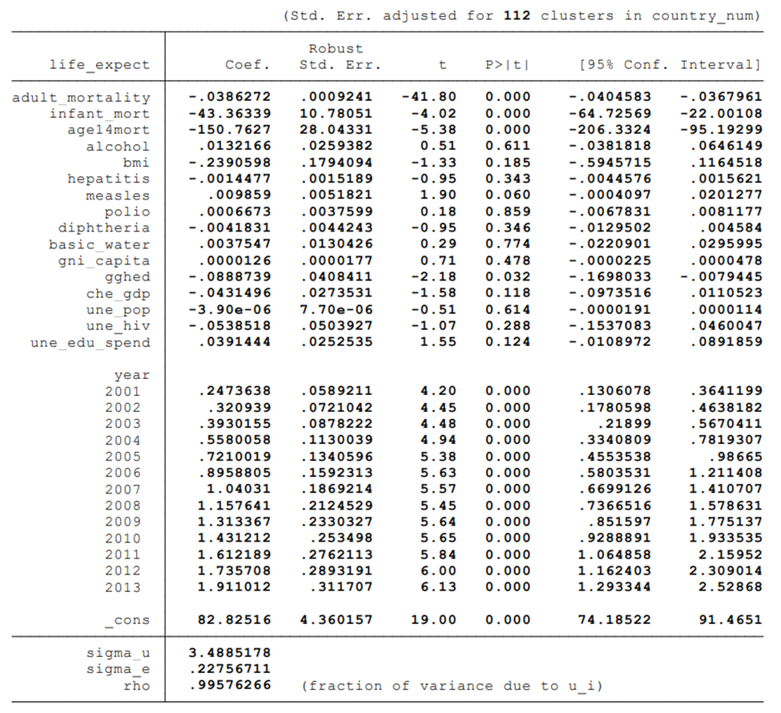

Slide 16
Rectification of Non-normality
Three transformations were attempted:
logarithmic transformation: log(life_expect)
inverse transformation: 1/life_expect
Square-root transformation: (life_expect)^0.5
Each transformation still gave a non-normality result in Shapiro-Wilk test of normality

Slide 17


Slide 18
Conclusion: The Data
Topic- Life expectancy in Sub-Saharan Africa countries
Source- WHO , World Bank
Type - Panel (Highest quality rating)
Properties- Random etc. , Heteroskedastic, Approx Normal Residuals

Slide 19
Conclusion: The Model
Model- Linear in Parameters and Variables , Fixed effect Model
Y_{life_expect} = β₀ + β₁adult_mortality + β₂infant_mort + β₃age1-4mort + β₄alcohol + β₅bmi + β₆measles + β₇polio + β₈diptheria + β₉hepatitis + β₁₀basic_water + β₁₁gni_capita + β₁₂gghe-d + β₁₃che_gdp + β₁₄une_pop + β₁₅une_hiv + β₁₆une_edu_spend + γ₂₀₀₀+ γ₂₀₀₁+ γ₂₀₀₂+ γ₂₀₀₃+ γ₂₀₀₄+ γ₂₀₀₅+ γ₂₀₀₆+ γ₂₀₀₇+ γ₂₀₀₈+ γ₂₀₀₉+ γ₂₀₁₀ + γ₂₀₁₁+ γ₂₀₁₂+ γ₂₀₁₃+ γ₂₀₁₄+ γ₂₀₁₅+ γ₂₀₁₆
10% level insignificance | R^2 = 0.9792
10% level significance | F stat = 582.24
5% level significance
0.1 % level significance

Slide 20
Conclusion: The Results
From this regressive analysis, it can be concluded that in Africa life expectancy depends on adult mortality, infant mortality, mortality between age 1 to 4, percentage of children below 1 year getting Measles vaccine, domestic general government health expenditure (gghe-d) as well as the year. Rest of the factors like other vaccines of polio , diphtheria etc. though not individually, but jointly have a significant effect on life expectancy.

Slide 21
THANK YOU

